Slide 1
Movie App
Advanced Programming Project
Med Amine Machfar Feres Ben Youssef
Tunis Business School
Teacher: Dr. Boughanmi Najet Course: IT 370: Advanced Programming

Slide 2
Introduction
Overview of the Project:
In the era of digital entertainment, having a convenient and efficient way to browse and book movie tickets is essential. This project aims to provide a user-friendly movie app that simplifies this process for users.
The Movie App allows users to:
Browse a list of movies and view detailed information about each one.
Manage their movie passes easily.
Securely log in and register for an account.
Select preferred seats and showtimes for movies.
Let’s explore the details of how this app enhances the movie-going experience.

Slide 3
Project Goals
Objectives:
Develop a user-friendly application for browsing and booking movie tickets.
Provide detailed information about movies, including descriptions, ratings, and trailers.
Implement a secure login and registration system for users.
Offer a convenient way to manage movie passes.
Enable users to select preferred seats and showtimes easily.
By achieving these goals, the project aims to enhance the movie-going experience and streamline the process of booking movie tickets.

Slide 4
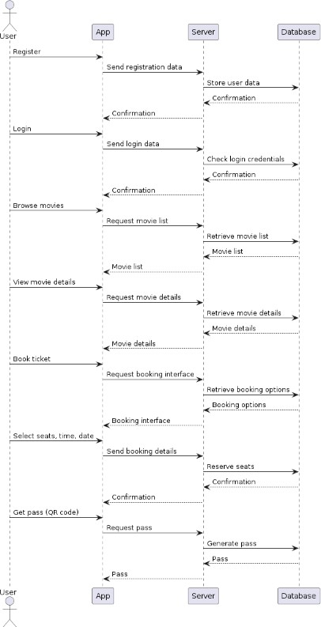
Application Workflow
Diagram: Sequence Diagram

Slide 5
Application Workflow (Cont)
Explanation:
User Interaction: Users browse movies, log in/register, and select their preferred movie and showtime.
Server Processing: The server processes user requests, retrieves movie details, and manages user authentication and movie pass information.
Seat Selection: The user selects seats for their chosen showtime, and the server checks availability and confirms the booking.
Feedback: The server provides confirmation of booking, updates the movie pass status, and sends notifications to the user.

Slide 6
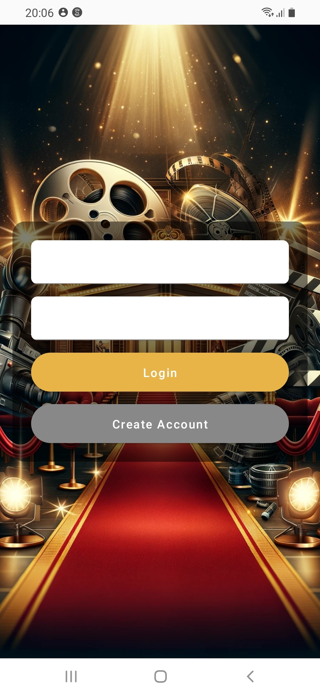
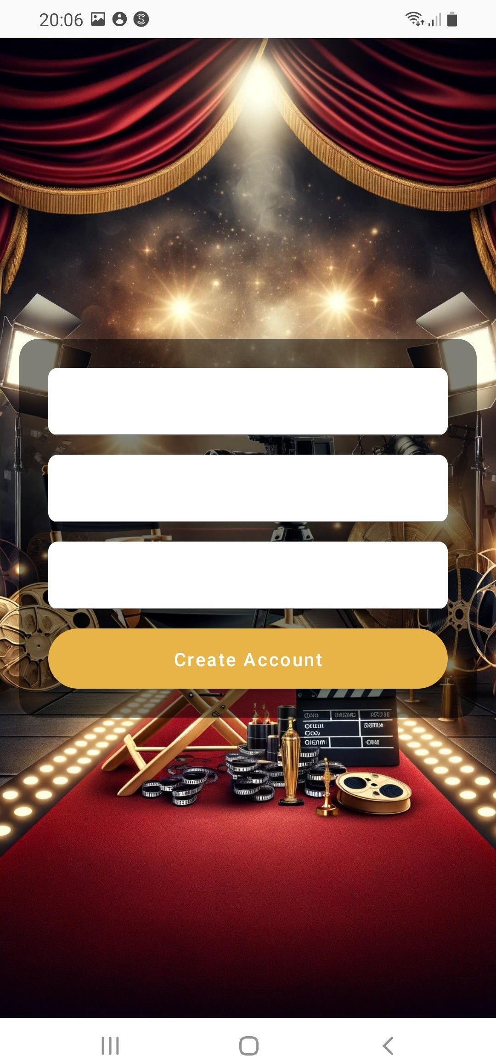
User Interface - Login/Register
Description:
Text input fields for username and password.
Buttons for login and registration. .
Figure: Login/Register Interface

Slide 7
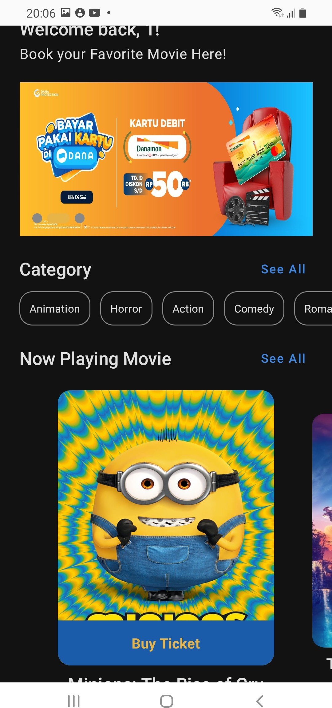
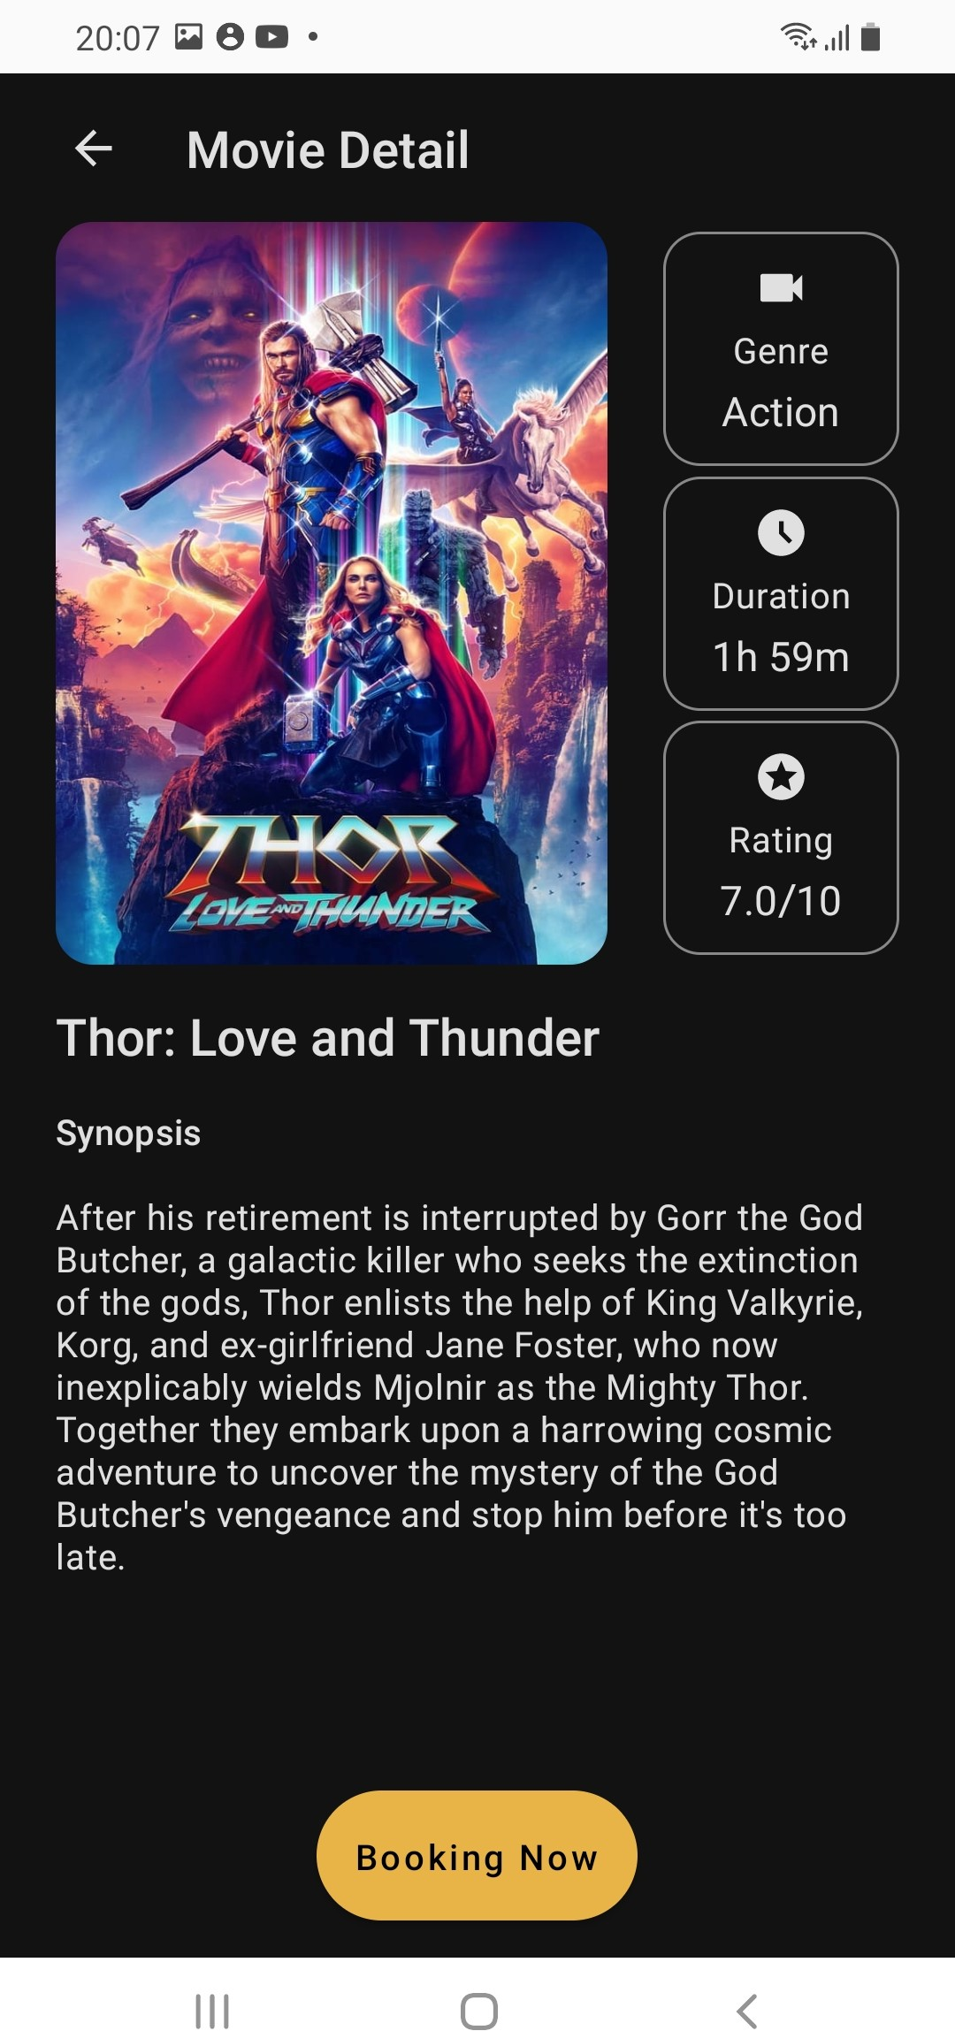
User Interface - Movie Browsing
Description:
Grid layout for displaying movie posters and titles.
Buttons and icons for sorting and viewing movie details.
Figure: Movie Browsing Interface

Slide 8
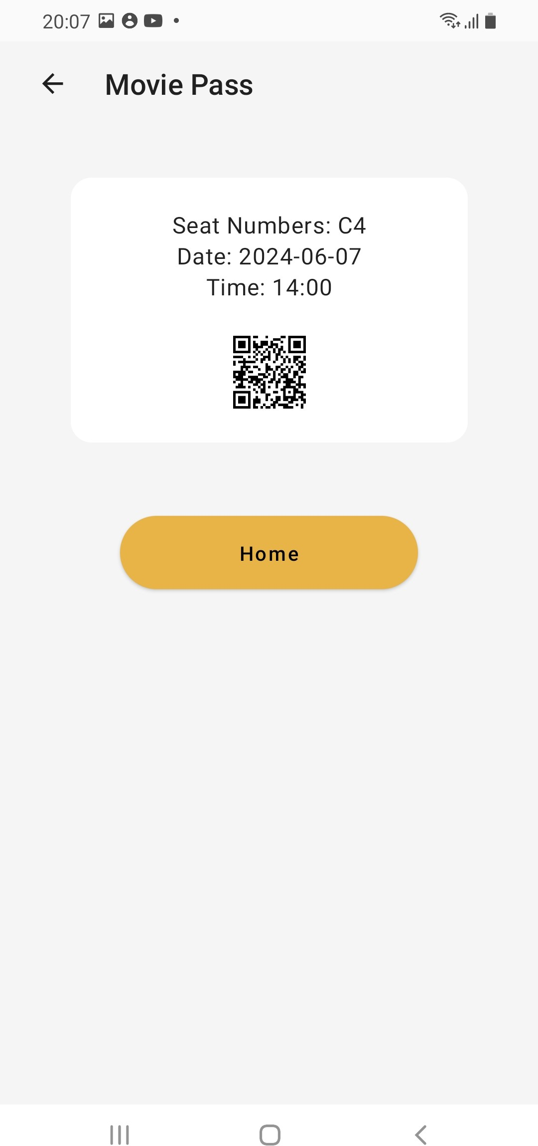
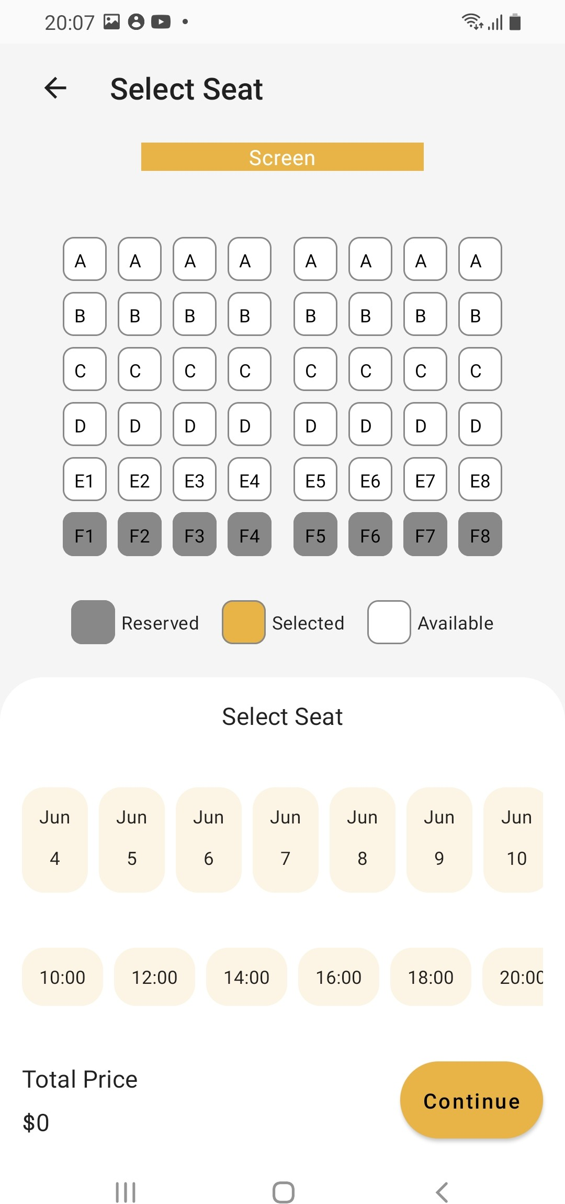
User Interface - Booking
Description:
selecting date and time.
Seat selection interface with interactive seat map.
Confirmation screen with booking details and QR code.
Figure: Booking Interface

Slide 9
Backend Logic
Movie Data Management:
Utilizes a database to store movie information.
Includes details such as movie title, description, genre, release date, and duration.
User Authentication and Authorization:
Implements secure login and registration processes.
Manages user sessions and permissions for accessing app features.
Ticket Booking and Management:
Handles seat availability and booking transactions.
Generates QR codes for tickets and manages ticket statuses.

Slide 10
Code Explanation
Key Functions:
User.kt: Contains the user class definition with attributes such as username, email, and password. It also includes methods for user authentication and profile management.
Movie Model.kt: Defines the movie class with properties like title, description, genre, and release date. This file also contains methods for retrieving movie information and managing movie passes.
Movie pass Screen.kt: Manages the booking process, including seat selection, showtime selection, and ticket generation. It contains methods for booking confirmation and updating ticket status.
AppDatabase.kt: Handles database operations for storing and retrieving user, movie, and booking information. This file includes methods for CRUD (Create, Read, Update, Delete) operations on the database tables.

Slide 11
Technical Challenges
Challenge 1: Implementing the seat selection interface with an interactive seat map was challenging due to the complexity of managing seat availability and user selections.
Challenge 2: Retrieving and displaying movie descriptions, ratings, and trailers from the database posed a challenge due to the complexity of managing and displaying large amounts of data while ensuring smooth app performance.
Challenge 3: Implementing secure user authentication and authorization processes to protect user data and prevent unauthorized access.

Slide 12
Future Enhancements
Enhancement 1: Implementing a recommendation system to suggest movies based on user preferences and viewing history.
Enhancement 2: Integrating a payment gateway to allow users to purchase movie tickets directly through the app.
Enhancement 3: Adding a social media integration feature to allow users to share their movie experiences with friends.

Slide 13
Conclusion
The Movie App aims to revolutionize the movie-going experience by providing a convenient and user-friendly platform for browsing and booking movie tickets.
With its intuitive user interface, robust backend logic, and future enhancements planned, the Movie App is poised to become a go-to choice for movie enthusiasts.
We are excited about the future of the Movie App and look forward to implementing new features and improvements based on user feedback and technological advancements.
Thank You For Your Attention !

